Slide 1
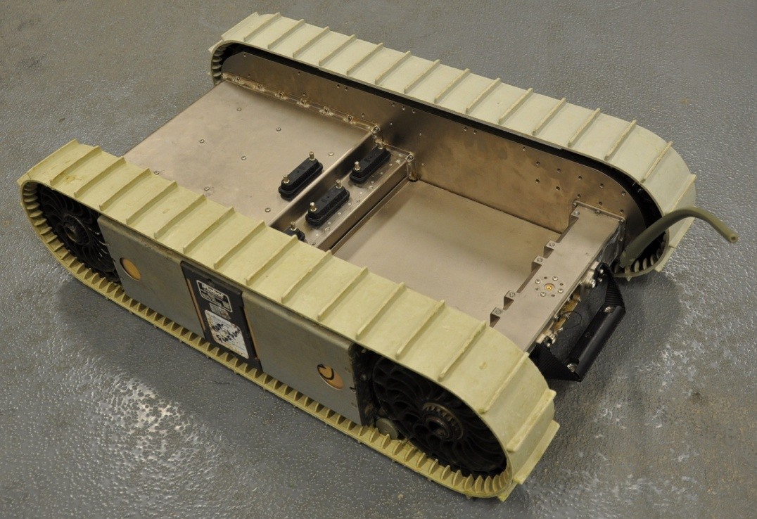
PackBot Chassis Anatomy
Chassis
Payload Bays
BB-2590 Battery
Battery Cradle

Slide 2
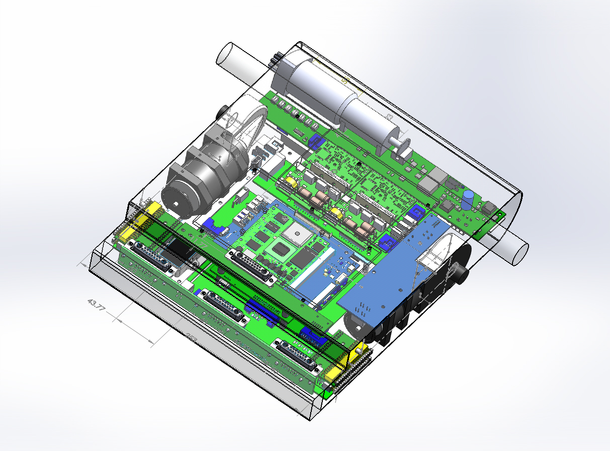
Left Lower Siderail Interface Board
DC Motor Interface Board
Upper Payload Connector Board
Upper Siderail Interface Board
Flipper Board
Mobility Board
AHRS Mounting Board
DC Motor Interface Board
Right Lower Siderail Interface Board
Lower Payload Connector Board
Upper Siderail Interface Board

